Slide 1
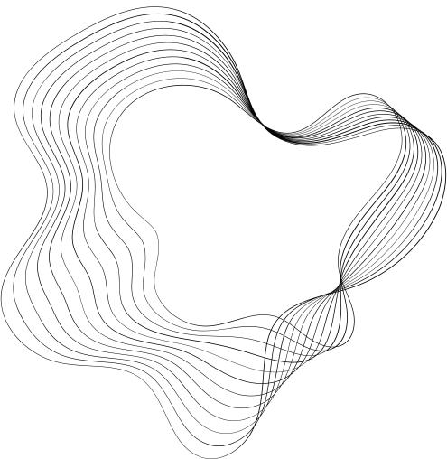

CARDIOVASCULAR RISK
PROJECT
AADITYA MAHINDRAKAR

Slide 2
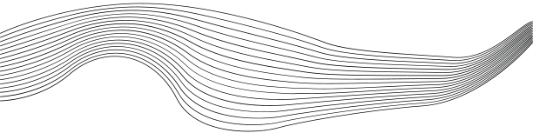
CONTENT
01
BRIEF
02
ASSUMPTIONS FOR PREPROCESSING
03
ANALYSYS
04
MODEL COMPARISON
05
EVALUATION
06
CONCLUSION
07
NEXT PROJECT

Slide 3




BRIEF
Cardiovascular risk refers to the likelihood or probability that an individual will develop cardiovascular diseases (CVDs) during their lifetime. Cardiovascular diseases are a group of conditions that affect the heart and blood vessels, and they are a leading cause of morbidity and mortality worldwide. Cardiovascular risk assessment is essential for understanding an individual's susceptibility to these diseases and for implementing preventive measures to reduce their risk.
Several factors contribute to cardiovascular risk.
The dataset is from an ongoing cardiovascular study on residents of the town of Framingham, Massachusetts. The classification goal is to predict whether the patient has a 10-year risk of future coronary heart disease (CHD). The dataset provides the patients’ information. It includes over 4,000 records and 15 attributes.
-Variables.
Each attribute is a potential risk factor. are both Theredemographic, behavioral, and medical risk factors.

Slide 4

Dropping missing values from 'cigsPerDay' feature, because this is a crucial information to predict the risk and if mean, or mode technique is used then the integraty of the data for prediction would be lost.
The approach taken to missing values in 'glucose' is that, ig the person is diabetic then na value = 126, because this is shooting point of suger to diabetic patient. And if the person is not diabetic then na value = 70 which is normal in healty person
'TotChol' = mean is taken for na values.
TotChol
cigsPerDay
glucose
education
BPMeds
BMI
heartRate
In approch taken for filling the missing null values from the variable'BPMeds', is considered 1, on the basis of whether the person had 'prevalentStroke' or 'prevalentHyp'.
For na values of the BMI variable, is filled with number '25'. The reference information by Massachusetts Department of Public Health, suggest that the average population in Massachusetts state is in BMI category of 'overweight' which falls under the scale of BMI,the minimum measure is 25.
To determine the 'heartRate' of a 64 year old person, that is in range of 60 - 100, assumed na value = 65 bpm.
To fill missing values in 'education' variable, used 'mode' techique.

Slide 5
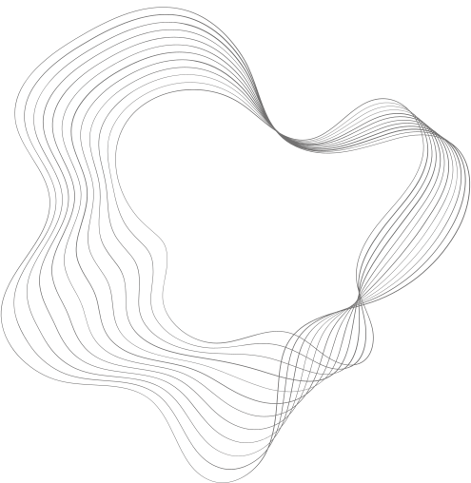
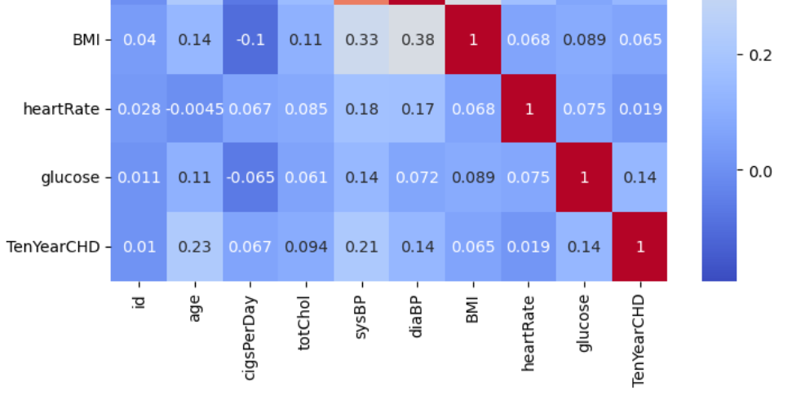
HEATMAP
Age, glucose, systolic Blood Pressure & Diastolic Blood Pressure are important to find cardiovascular risk

Slide 6

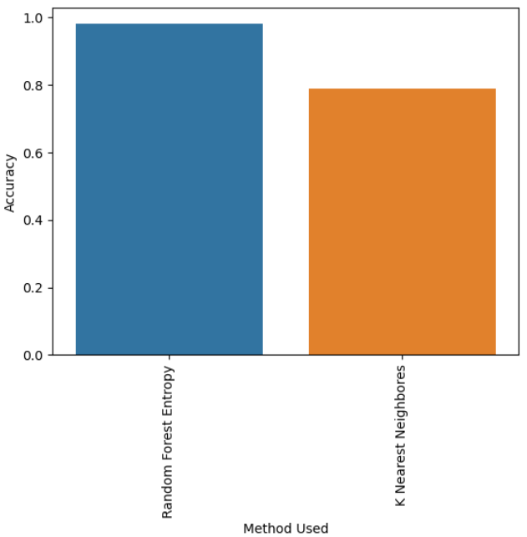

MODELS
RFE
KNN
A Random Forest model with entropy uses decision trees to make predictions. It selects the best splits based on information gain (entropy), aiming to reduce uncertainty in classification tasks.
K-nearest neighbors (KNN) is a supervised machine learning algorithm. It assigns a class label to an input based on the majority class of its nearest data points in a labeled dataset, using a user-defined value for K.
STRATEGY N°1
STRATEGY N°1

Slide 7
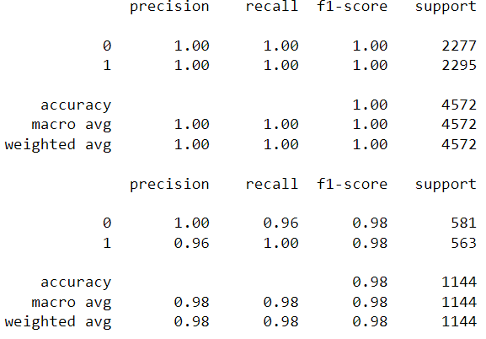
EVALUATION
Classification Report
A classification report is a summary of evaluation metrics for a classification model. It includes precision, recall, F1-score, and support for each class, helping assess model performance.
Confusion Matrix
AUC ROC
A confusion matrix is a table that shows a classification model's performance by summarizing the counts of true positives, true negatives, false positives, and false negatives, aiding in assessing model accuracy.
The Area Under the Receiver Operating Characteristic Curve (AUC-ROC) quantifies a binary classification model's ability to distinguish between classes. Higher AUC values indicate better model performance and discrimination.

Slide 8
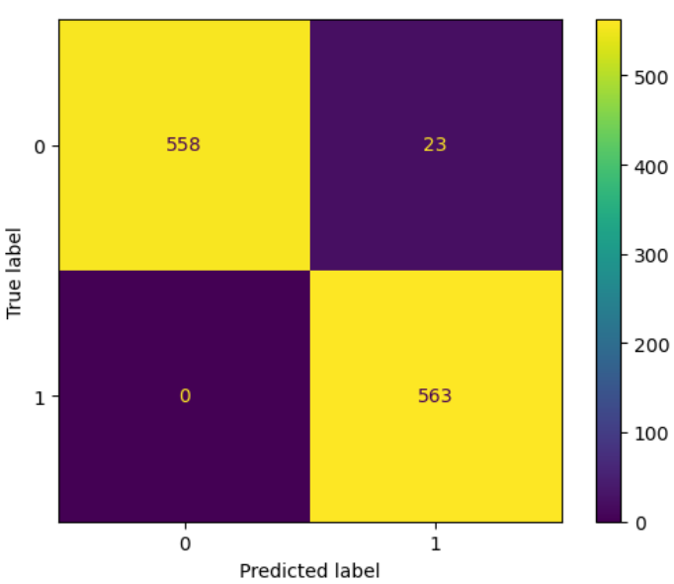
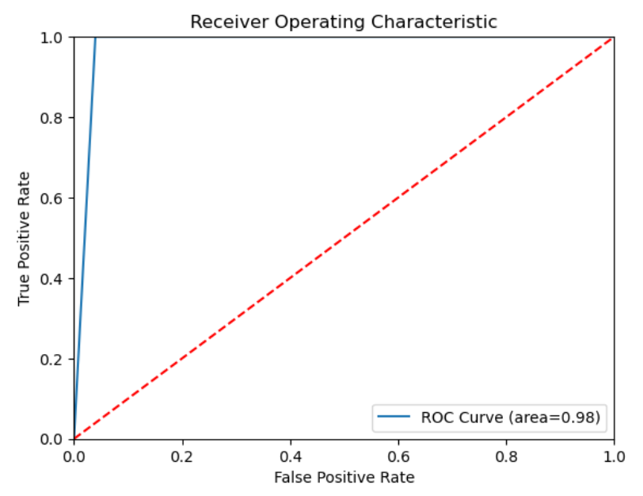
The confusion matrix tells us that, from the prediction of our model, is brilliant. It is accurately predicting actual to the predicted values, 23 times it has failed predicted negative cardiovascular risk to the patient , on the other hand it has accurately predicted risk to the actual patient, which I find fair in this case of Health Care Domain.
An AUC-ROC curve with a value of 0.98 indicates that a binary classification model has excellent discriminatory power. It accurately separates the two classes, with a high probability that a randomly chosen positive instance will rank higher than a randomly chosen negative instance in the evaluation.

Slide 9

CONCLUSION
Random Forest Entropy Model
name 'classifier1'
Train accuracy : 100 %,
Test accuracy = 97 %.
We need more data to check the model performance and to train the model robustly.
Having more crucial features, for example, Family History : whether there was any case of Cardiovascular disease in person's family background. And more specific data like 'Fasting Blood Sugar (Before Meals)', 'Post-Meal Blood Sugar (After Meals)', 'HbA1c (Glycated Hemoglobin) Levels’ and ‘excercise’.

